Slide 1
Version control, Git and GitHub

Slide 2
Version Control
Distributed Version Control
Git
GitHub Desktop
GitHub

Slide 3
What is Version Control or Source Control
It is the collection of systems that manage the changes in:
computer programs,
documents,
large web sites,
or other collections of information.
It is the logic and theory that serves as the basis for all the following.

Slide 4
Git
Git is not GitHub
Git is a software with its own programming language.
It is based on the distributed version control theory.
It is the most popular distributed version control system.
Notes:
Talk about integration with IDEs

Slide 5
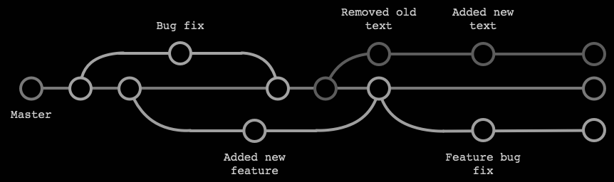
Git and distributed version control
Pro tip: don’t make slides at 11 pm
New Branch -> Work -> Pull request -> Merge -> Delete branch -> Rinse and repeat.
Also update(Pull) the changes that others made every now and then.

Slide 6
Git
"git" can mean anything, depending on your mood.
Random three-letter combination that is pronounceable, and not actually used by any common UNIX command. The fact that it is a mispronunciation of "get" may or may not be relevant.
Stupid. Contemptible and despicable. Simple. Take your pick from the dictionary of slang.
"Global information tracker": you're in a good mood, and it actually works for you. Angels sing, and a light suddenly fills the room.
"Goddamn idiotic truckload of sh*t": when it breaks.
Linus Torvalds - Creator of Git

Slide 7

GitHub Desktop
GitHub Desktop
Git
Notes:
Talk about integration with IDEs

Slide 8
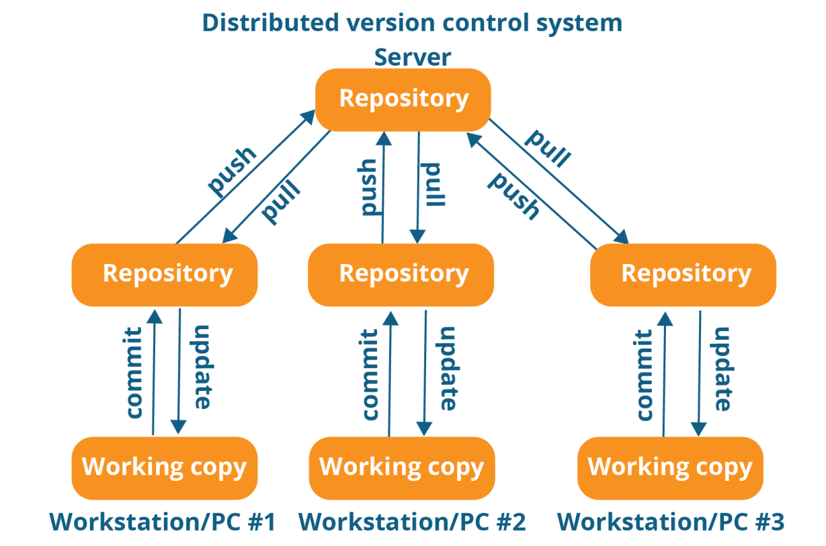
GitHub
This is GitHub Desktop
This is GitHub
This is your active branch
This is your PC

